Slide 1
Communication
Communication
Communication is a two-way process between a sender of a message and a receiver of a message. Communication is an exchange not just a give! ALL parties must participate to complete the information exchange.
definition

Slide 2
Communication
Communication
Message
Feedback
Sender
Receiver
Sender:
Thinks of / invents the message
Codes the message
Receives feedback
Receiver:
Receives the message
Decodes the message
Gives feedback
impact

Slide 3

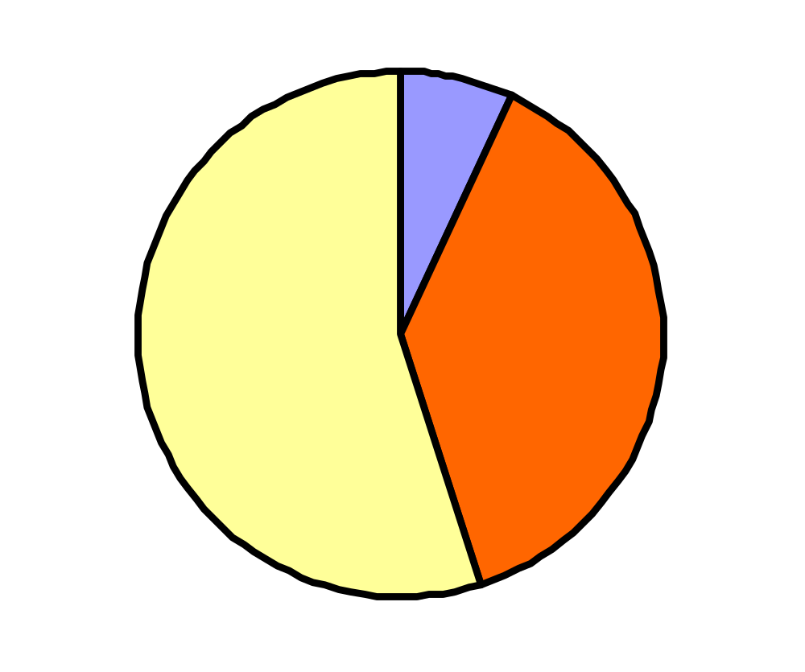
Communication
Communication: impact of a message
Words
7%
Non-verbal
38%
Voice
55%
verbal

Slide 4
Communication
Verbal communication
Words we say
Different people may interpret the same word differently! The word “gas” for example means something different in the UK (gas for cooking) then it does in the USA (petrol for car).
Voice
Tone of the voice,
Volume of the voice
Pitch/pace in which we speak.
Silences and pauses
tone
47

Slide 5
Communication
Non-Verbal communication
Eye contact
Facial Expressions
Gestures
Posture and body orientation
Proximity
Movement
Non-verb
47

Slide 6
Communication
Non-Verbal communication
Matching what you say and how you say increases impact!
Helps you to read between the lines
Language of subconscious
Body language interpretation depends on social & cultural background
exercise
47

Slide 7

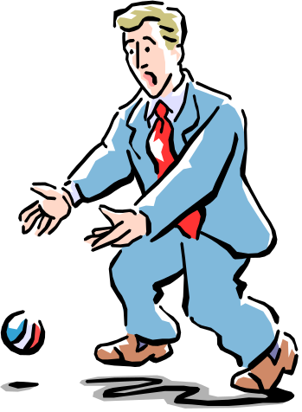
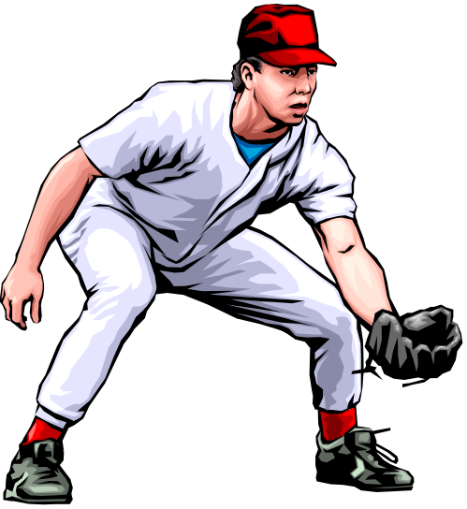
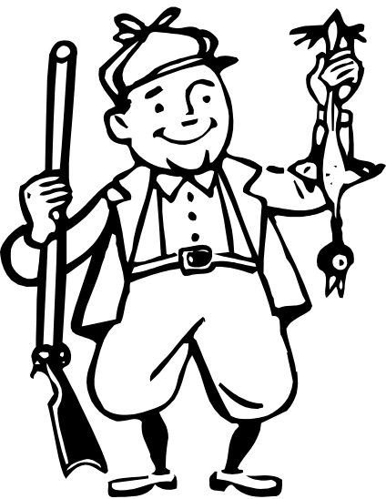

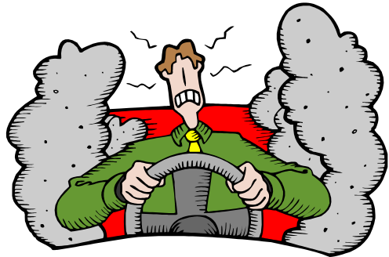
Communication
2.
3.
2
1.
4.
5.
6.
65
Com quest

Slide 8
Communication
Communication questions
Give answers to following questions:
Why = The Purpose.
Who = The audience
What = The Message.
How = The Medium.
Where = The Channel.
When = The Timing.
exercise
47

Slide 9
Communication
Prevent communication problems
Put yourself in the other's shoes
Try to understand each others perceptions
Check your assumptions.
Ask feedback questions: e.g.: “Do you understand?”
exercise
47

Slide 10

Communication
barrier

Slide 11
Communication
Stages in communication
3. Transmitting The Message
Sender
Receiver
1. Conceiving The Idea
4. Receiving The Message
2. Encoding The Message
5. Storing The Message
6. Reproducing The Message
7. Acting Or Reacting

Slide 12

Communication
Pitfalls in the stages of communication
1. Conceiving the idea
Possible Pitfalls
Wrong Idea
Lack of Forethought
Poorly Formulated
No Objective
Suggested Actions
Know Your Target Audience
Prepare and Rehearse
Align Presentation with Audience Objective

Slide 13
Communication
Pitfalls in the stages of communication
2. Encoding the message
Possible Pitfalls
Assumptions are made
Jargon is Used
Wrong Level Of Language
Lack of
Preparation
Suggested Action
Use Audience Language
Raise / Lower the Jargon Level
Prepare and Practice
Anticipate Questions and Prepare Replies

Slide 14
Communication
Pitfalls in the stages of communication
3. Transmitting the message
Possible Pitfalls
Interruptions
Distractions, Accents
Incorrect Media
Ineffective Body
Language
Suggested Actions
Set up The Venue
Create Open Atmosphere in the Beginning
Choose Multiple Media
Repeat, If Necessary
Keep Taking Feedback

Slide 15
Communication
Pitfalls in the stages of communication
4. Receiving the message
  Possible Pitfalls
Lack of Motivation Of Audience
Distractions
Misunderstanding
Mental Block
Suggested Action
Show Incentive to Audience
Reinforce through Examples
Build & Show Conviction
Keep Taking Feedback

Slide 16
Communication
Pitfalls in the stages of communication
5. Storing the message
Possible Pitfalls
Lack of Notes
Poor Memory
No Visual aids
To Much Information
Suggested Action
Keep It Short & Simple
Multiple Media Use
Communicate Through Imagery
Encourage Note Taking

Slide 17
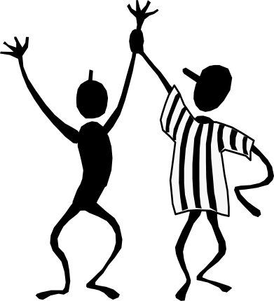
Communication
Pitfalls in the stages of communication
6. Reproducing the message
Possible Pitfalls
Distortion
Misrepresentation
Suggested Action
Reinforce Sometime Later
Mystery Shop, If Possible

Slide 18
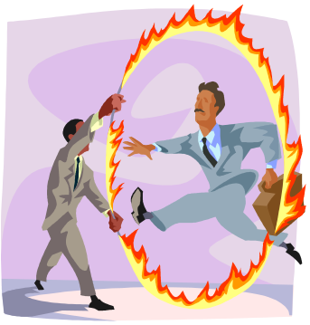
Communication
Pitfalls in the stages of communication
7. Acting or reacting
Possible Pitfalls
Lack Of Motivation
Failure of All Earlier Stages
Suggested Actions
Take Care of All Previous Stages

Slide 19

Communication
Barriers in communication
Physical
  Noise
  Interference
Psychological
  Prejudice
  Ego
  Insensitivity
  Mind Talk
  Assumption / perception
Semantic
  Accent
  Language quality
  Jargon
barrier

Slide 20
Communication
Barriers in communication
Message is “lost” or poorly-expressed
Communication is not “tuned” to the recipient
Patronizing tone
Inappropriate channel
Media failure
Message was not understood
Communication open to misinterpretation (additional messages)
Operating from assumptions / own perceptions
Strat. minim

Slide 21
Communication
Strategies to minimize barriers
Noise free environment.
Use natural language, appropriate for audience.
Avoid using controversial language, examples,
Be empathetic – understand other person’s feelings.
Be - a good listener.
Don’t indulge in cross conversations.
Avoid mind talk.
Don’t argue. Arguments lead to conflicts
successful

Slide 22
Communication
Features of successful communication
Clear, well-prepared message.
Targeted to the recipient/audience.
Relevant tone or “pitch”.
Timed so the receiver is prepared to accept it.
Key points are clear.
The sender checks that the receiver has understood.
Delivered using the best medium.
written

Slide 23
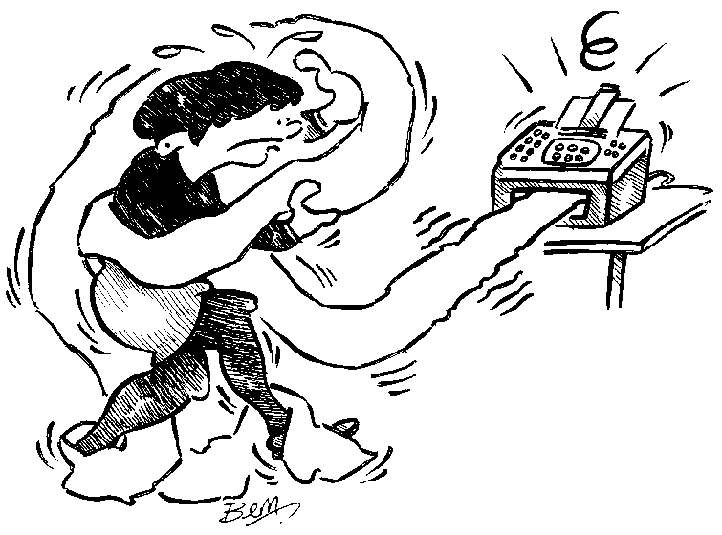
Communication
Written communication

Slide 24
Communication
Written communication
Ask yourself:
Do I need a record?
Is it a complex message?
Does the receiver need time to respond?
Do many people need to receive this message?
Is it a formal message?
Am I having difficulty contacting the receiver?
meaning

Slide 25
Communication
Written communication – netiquettes
Pay attention to punctuation, spelling, grammar and capitals.
Your subject line should be descriptive.
Don’t change original wording whilst Forwarding mails
Use short paragraphs and leave lines between them
Tidy up your e-mail
Don't send unsolicited attachments.

Slide 26
Communication
Written communication – netiquettes
Ensure that your PC is protected against viruses.
Don't type in ALL CAPITALS
Thou shalt not spam!
Wait a while before sending your message, if emotions are involved.
Remember the human
Adhere to the standard of behaviour as you would follow in real life.
Avoid unnecessary CCs

Slide 27
Communication
Saying what you mean and meaning what
you say:
Keep it short.
Be specific.
Don’t apologize.
Cut out detail and explanation.
Use statements, not questions.
Say no and mean it.
Use “I”.
exercise

Slide 28
Communication
Effective presentations
Delivering your presentation effectively
involves using a proven four - step process:
Plan
Prepare
Practice
Present
prepare

Slide 29
Communication
Effective presentations
Prepare:
What is the objective?
What is my expectation?
What is my audience’s goal & expectation?
Who is my audience i.e. their age, gender, occupation, experience etc.
The audience’s knowledge of the subject
The audience’s attitude towards the subject
The duration & venue of the presentation
The size of the audience
content

Slide 30
Communication
Effective presentations
Content:
Tell what you are going to tell: Introduction and objective
Tell what you want to communicate: Main body and message
Tell what you have told:
Summary and Conclusion
Vis.aids

Slide 31
Communication
Effective presentations
Visual aids:
A picture communicates more then a thousand words!
Speak to the audience...NOT to the visual aid.
Use no more than 7 lines of text per page and no more than 7 words per line (the 7&7 rule)
exercise

Slide 32

Action plan
        Reflect on content of this module: communication introduction.
What did you learn?
What action steps am I going to take to become a better communicator?
Discuss your learning and action steps in pairs and help each other improve your action steps.
Note your final action steps in your action plan.
101
Agenda

Slide 33
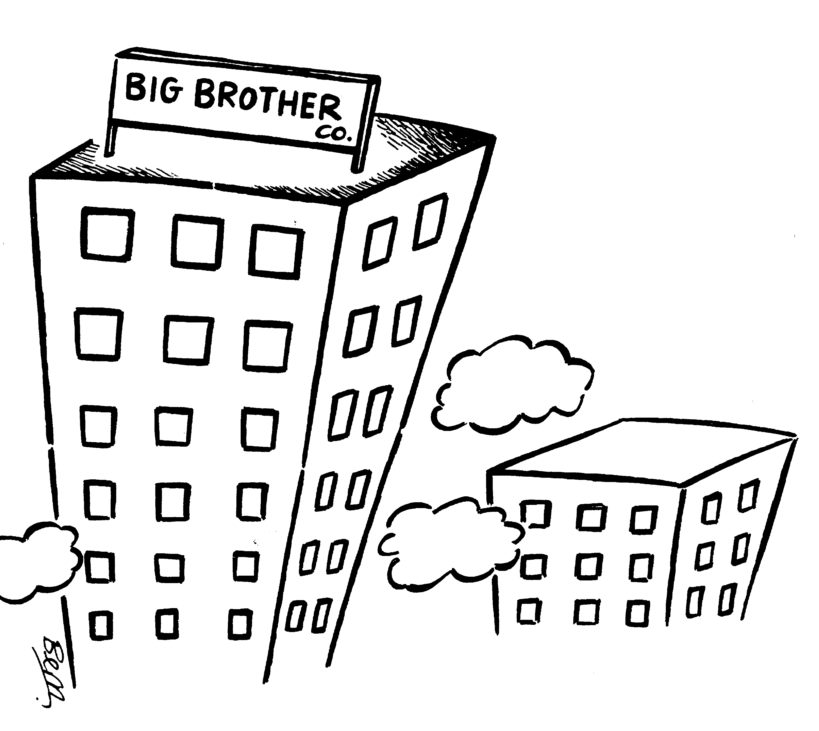
Communication styles
Communication styles
Personal Communication Styles
Organizational Communication Styles
S-ladder

Slide 34
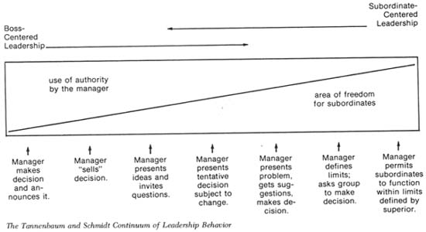
Communication styles
Personal communication styles

Slide 35

Communication styles
Personal communication styles: The S ladder
5.
Sanctioning
5. Give full responsibility (authorize)
4. Share decision-making process and share work
3. Ask for ideas
2. Encourage and motivate
1. Give instruction
4.
Sharing
3.
Suggesting
2.
Stimulating
1.
Signaling
77-80
S-ladder

Slide 36
Communication styles
The ability of staff
Staff with high knowledge levels, advanced skills and lots of motivation and confidence
5.
Sanctioning
4.
Sharing
3.
Suggesting
2.
Stimulating
Staff with low knowledge, skill, motivation or confidence
1.
Signaling
77-80
exercise

Slide 37
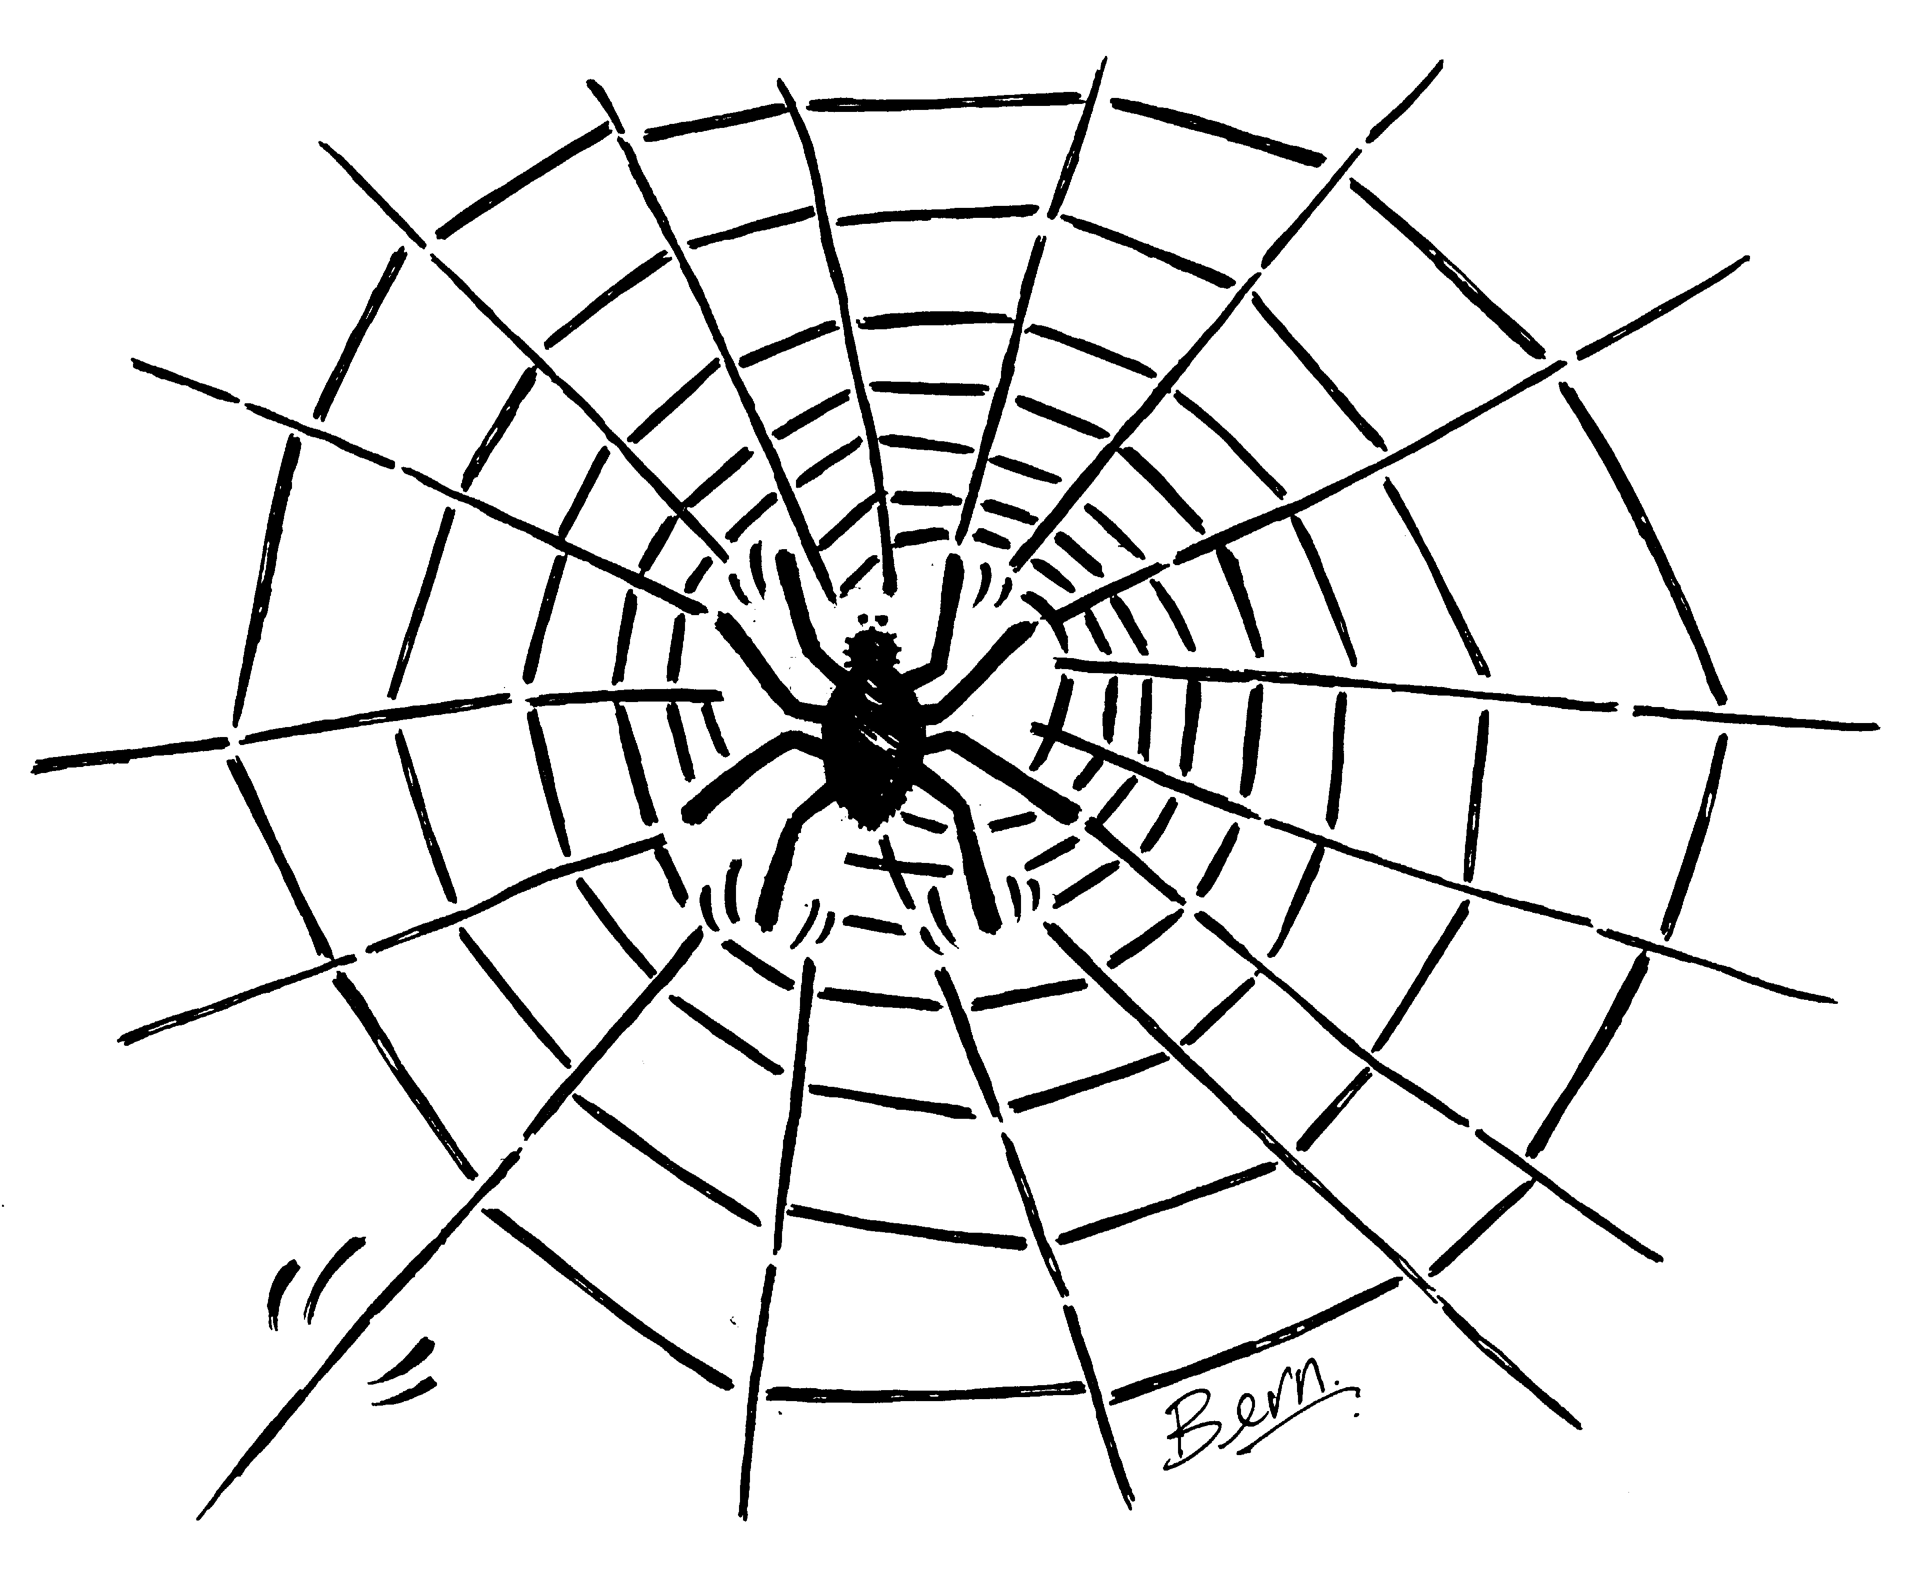
Communication styles
Organizational communication styles
Power
One powerful individual communicating (mainly) verbally from the center.
role

Slide 38

Communication styles
Organizational communication styles
Role
Traditional, hierarchical structures split into different functions. Formal procedures. Lots of written communication.
task

Slide 39
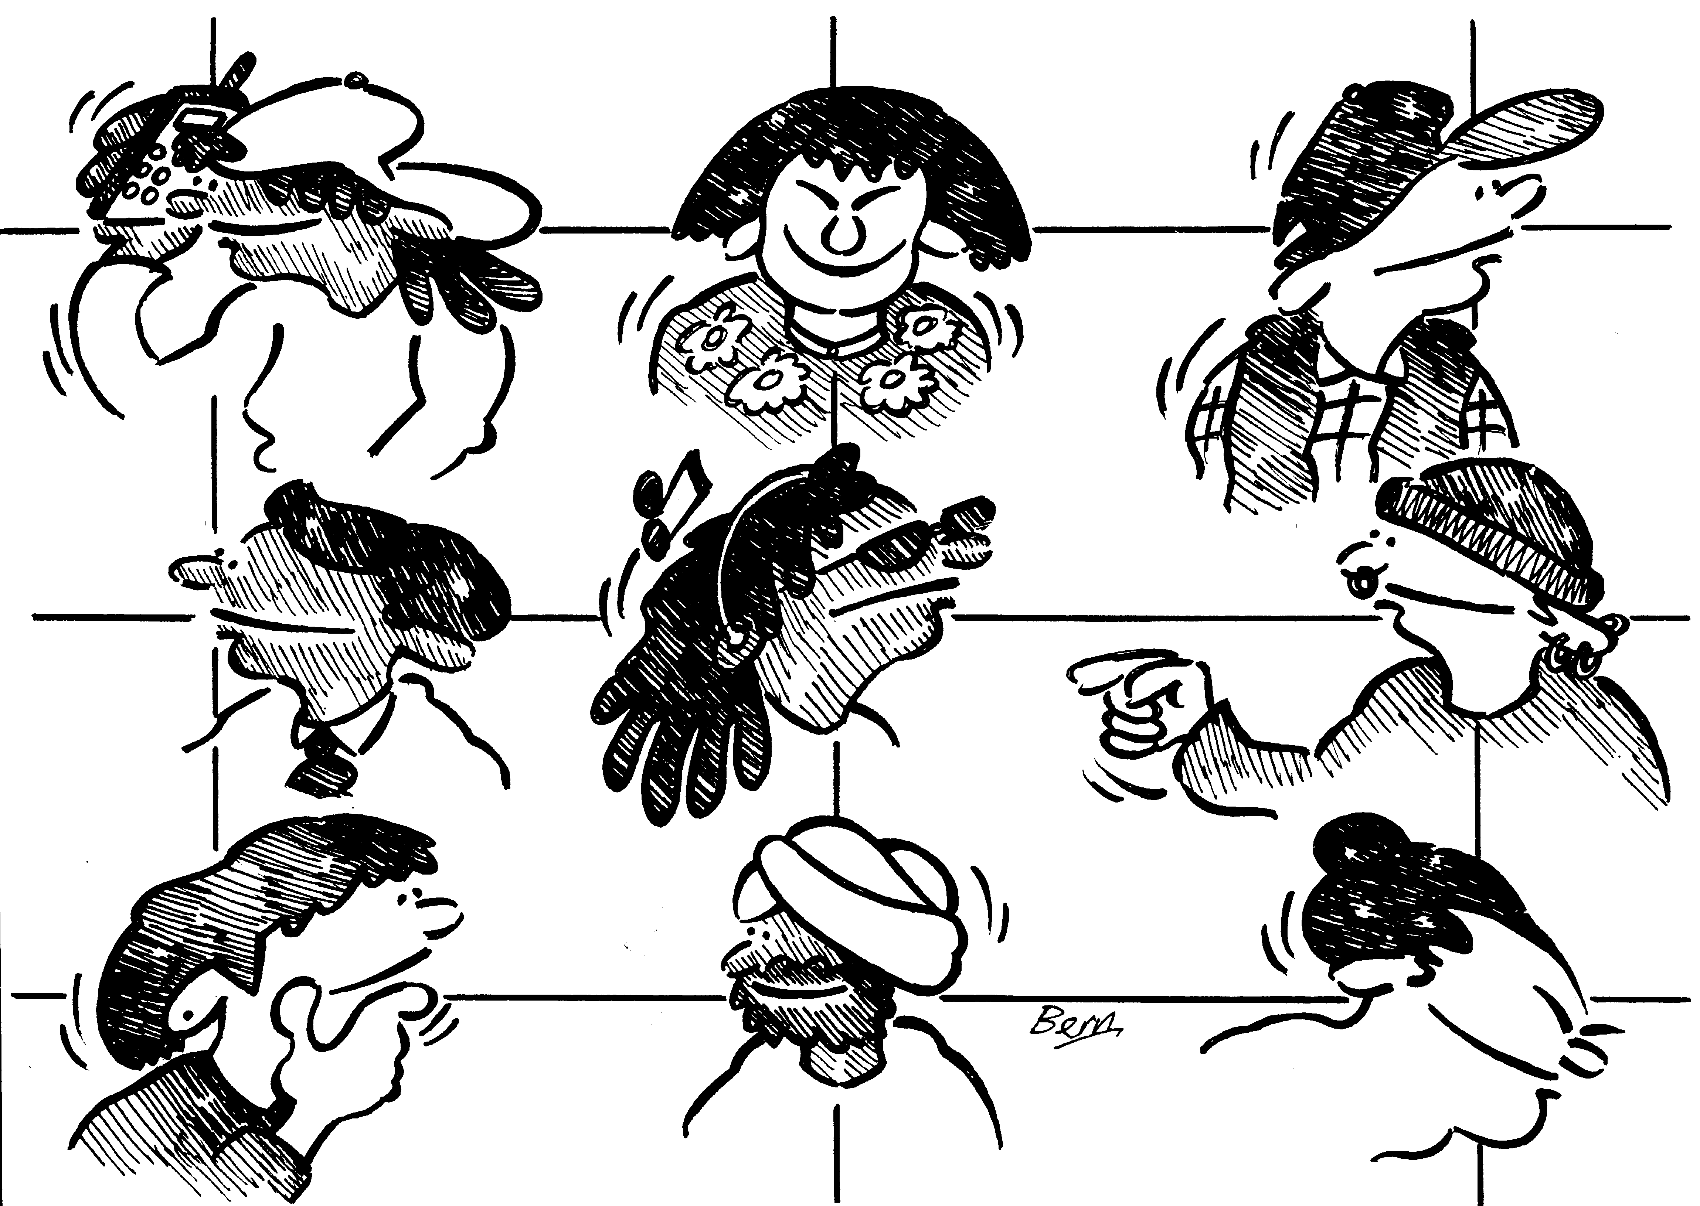
Communication styles
Organizational communication styles
Task
A group of specialists (often a project team) exemplified by their creativity and ability to act fast. No one reports to anyone else and the priority is usually to get the job done.
person

Slide 40
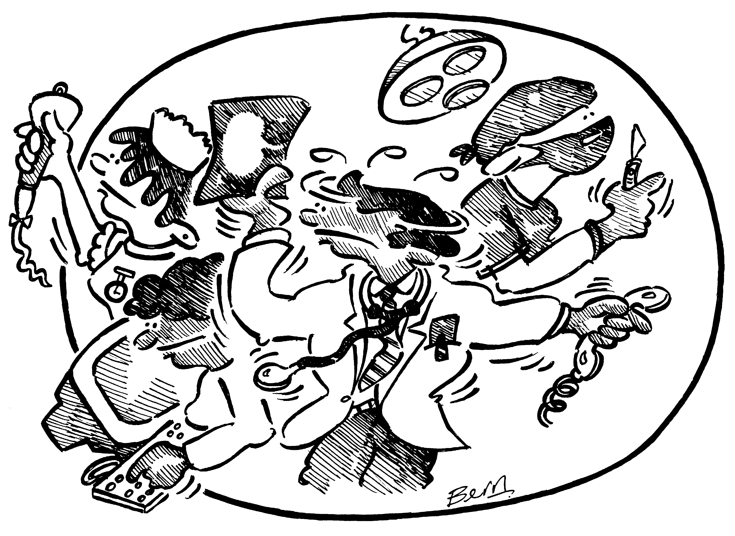
Communication styles
Organizational communication styles
Person
A number of people with common shared needs who find it convenient to work under one roof, for example. (Think of architects, medical specialists or university professors.)
exercise

Slide 41
Action plan
        Reflect on content of this module: communication styles.
What did you learn?
What action steps am I going to take to become a improve my communication style?
Discuss your learning and action steps in pairs and help each other improve your action steps.
Note your final action steps in your action plan.
101
Agenda

Slide 42
Listening
“A good listener is not only popular everywhere, but after a while, he gets to know something.”
Wilson Mizner
cartoon

Slide 43
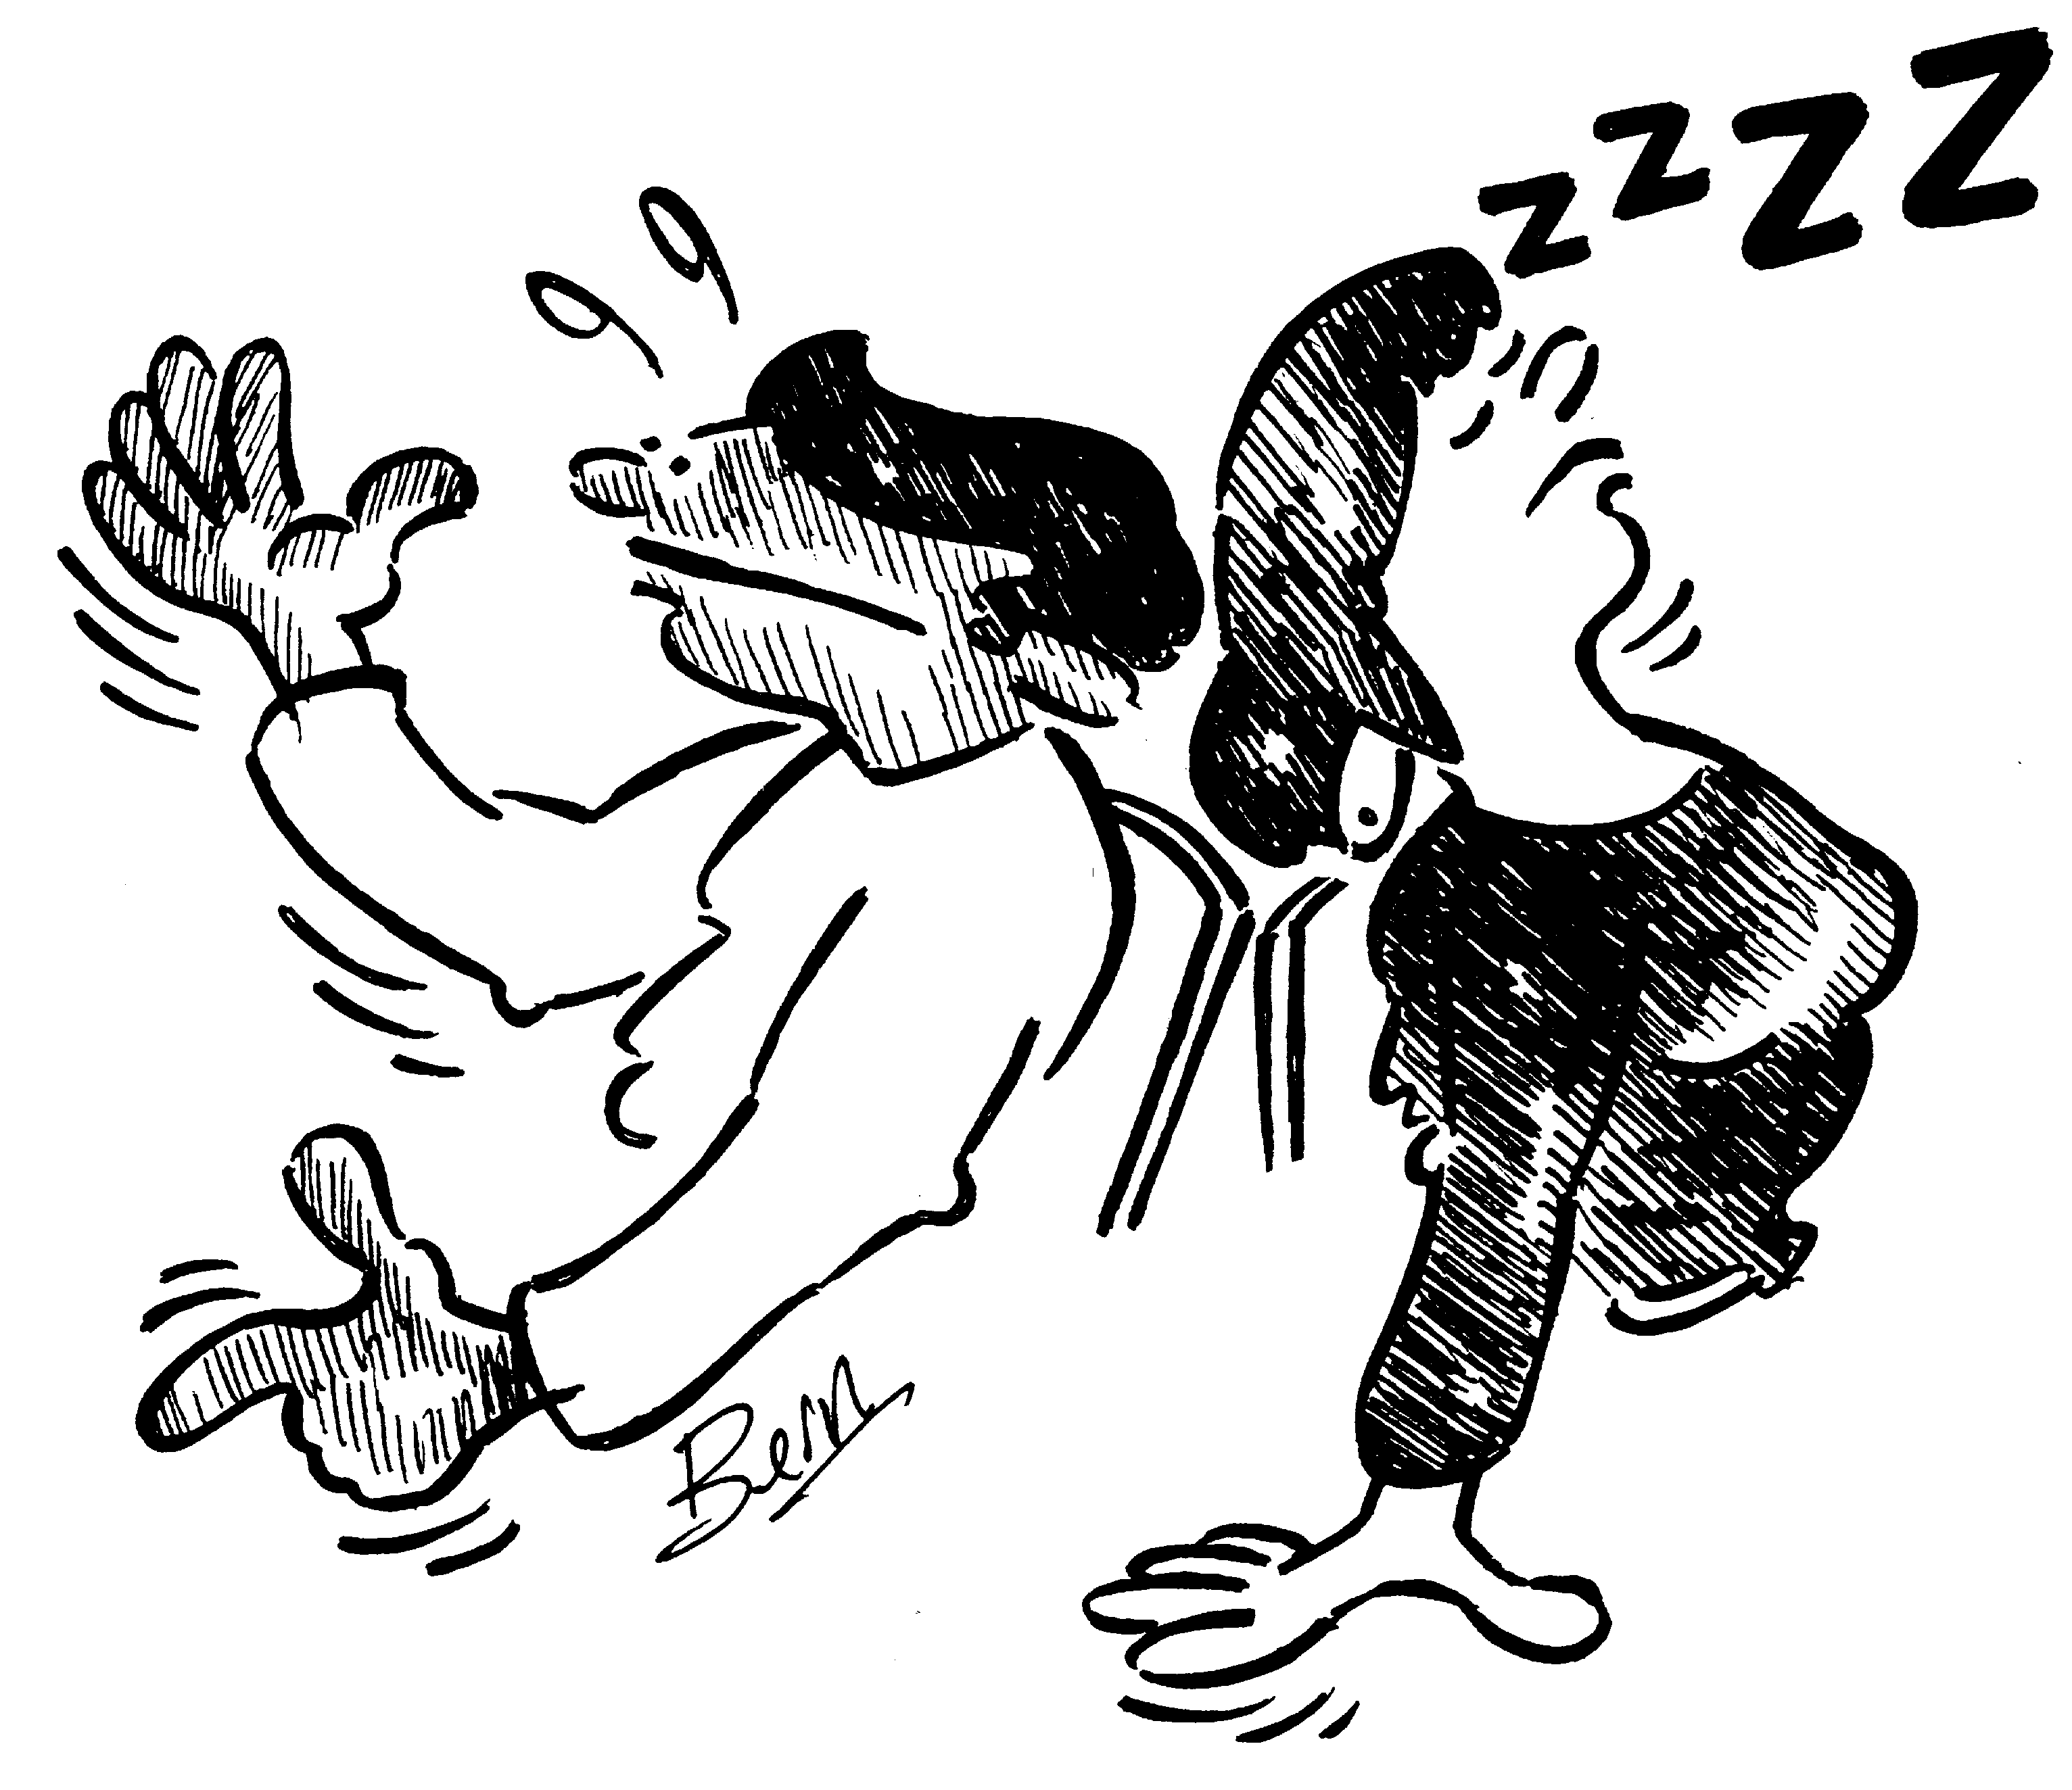
Listening
exercise

Slide 44
Listening
5 levels of listening
Ignoring
Pretending
Selective
Active
Empathic
Active

Slide 45
Listening
Essential requirements for good listening
Intensity
Empathy
Acceptance
Responsibility for completeness
exercise

Slide 46
Listening
Active listening
Make eye contact
Exhibit affirmative head nods and facial expressions
Avoid distractions and distracting gestures
Ask questions
Paraphrase
Don’t over talk
Don’t Interrupt
Make smooth transactions between the role of the speaker and the listener
87 - 88
probing

Slide 47

Listening
Probing
Enables us to increase understanding
Ask questions
  Open ended
  Closed
Empathic l

Slide 48
Listening
Empathic listening
SKILL
ATTITUDE
Empathic l

Slide 49
Listening
Empathic listening
When we are not sure we understand
When we are not sure the other person feels understood
When the interaction has a strong emotional component
Empathic l

Slide 50
Listening
Empathic listening responses
Repeat, exactly, what was said
Rephrase content
Reflect feelings (heard and seen!)
Tell the difference when not necessary
or appropriate
Use structure:
“You feel <feeling> about <topic>”
exercise

Slide 51
Listening
Summarizing
Summarize conversations at the end of a conversation or during a conversation to check understanding of both parties. Do this by:
Make notes during conversation
Reflect Key points
Act.pln

Slide 52
Action plan
        Reflect on content of this module: listening.
What did you learn?
What action steps am I going to take to become a better listener?
Discuss your learning and action steps in pairs and help each other improve your action steps.
Note your final action steps in your action plan.
101
agenda

Slide 53
Persuasion
Influencing strategies
Friendliness
Assertiveness
Reasoning
Bargaining
Coalition
Higher Authority
Sanctions
91-94
friendliness

Slide 54
Persuasion
Friendliness:
You create favorable impressions as a mean to obtain what you want.
Caution: Overuse of this strategy could lead your subordinates / peers doubt your motives and your work competence.
91-94
assertiveness

Slide 55
Persuasion
Assertiveness:
You use direct requests and demands. May be accompanied with displays of strong emotion and refusal to take ‘no’ for answer.
Caution: this strategy is a double edged sword: can create support or ill will.
91-94
reasoning

Slide 56
Persuasion
Reasoning:
Shows persuasion on basis of objective merits by avoiding emotions and relying mainly on reason.
Caution: requires preparation, time, thought, ability to present the case logically and communication skills.
91-94
bargaining

Slide 57
Persuasion
Bargaining:
Indicates that you attempt to influence by offering to do something in exchange.
Caution: Drawback of this strategy is that over a period of time subordinate may feel no worth for what is offered in exchange. may create obligations at times.
91-94
coalition

Slide 58
Persuasion
Coalition:
Indicates that you use social pressure or take support of others as a mean to obtain what you want.
Caution: Overuse of this strategy could lead your subordinates / peers feel that you are conspiring against them.
91-94
Higher autho

Slide 59
Persuasion
Higher Authority:
Indicates that you call on higher management to help you handle your problems you are facing in influencing your subordinates / peers.
Caution: Overuse of this strategy could undermine your relationship with subordinates / peers.
91-94
sanctions

Slide 60
Persuasion
Sanctions:
Indicates that you use ‘striking back’ as a strategy if task is not done.
Caution: Overuse could lead your subordinates / peers label you as revengeful & nasty. May lessen the relationship and leading to low trust on you.
91-94
Infl. skills

Slide 61
Persuasion
Core influencing skills
Probing and try to understand
Listening: be influenced first before influencing the other!
Persuade by using appropriate influencing style
Awareness of body language
negotiations

Slide 62
Closing
“We must become the change we want to see!”
Mahatma Gandhi
thank

